Slide 1
Cultural to Business Hackthon
Lavinia Simion
Project manager for Municipality of Timisoara

Slide 3
Action 1- Cultural to Business Hackathon
Implemented in August 23-25, 2021 in partnership with Flight Foundation, the organizer of Flight Festival at Iulius Town
● developed the visual identity of the event
● developed an online a social media page on Facebook
● created and promoted the concept among the local community using in the visual identity of the event, the IE program and the ECoC-SME project
● sent press release to the local media and published to the Municipality website
● ECoC-SME project roll-up was present at the venue
● estimated promo impact in mass media and social media was 5k, and we reached 17k

Slide 4
Action 1- Cultural to Business Hackathon
● created an online registration form for participants
● organized two pre-events containing an idea presentation session, a team work session and a networking component, which aimed at generating content and attracting participants
● estimated number of participants cumulated in the 2 pre-events was 30-40 people, while in the implementation of the two pre-events a number of 35 people participated

Slide 5
Action 1- Cultural to Business Hackathon
● 71 participants registered (63 registered on-line and 8 people registered on the spot)
●16 mentors and 7 jury members were involved in the process of helping the teams to validate both the problems they started from and the solutions they prototyped during the 3 days
●12 ideas were generated
●participants represented cultural and creative industries, business and technology (smart) sectors: estimated percentage 40% - ICC sector, 40% - technology sector, 20% - business sector
● participants developed business ideas in the cultural and creative sector, tourism and hospitality (business) and technology (smart cities) in the context of Timisoara European Capital of Culture with the help of mentors
● the program was free

Slide 6
Action 1- Cultural to Business Hackathon
●the following ideas were developed
nCity- application for restaurants, cafés, bars for customer loyalty by accumulating points and bonuses
City Radar - urban mobility application (public transport) which also includes cultural events, locations on the routes of local transport.
Discover around - application that lists all local events both large and small in one place, for visibility
Urban Hunter- application for tourists and locals to discover the city through guided tours on topics of interest
ReserveIT - application that allows you to reserve meals in the premises
Mappo - platform for monitoring traffic in the city and private parking lots and crowded public areas
7. Clevereat - application that solves the problem of food waste in restaurants

Slide 7
Action 1- Cultural to Business Hackathon
8. Bikey - platform for managing an urban bicycle parking network
9. CitizenTM - transparency application for public administration (participatory budget)
10. Fain Turism - application that allows the purchase of tickets for both public transport and events, through a personalized profile
11. Armed Synapse - application that allows the purchase of tickets online for museums
12. Artcity (not finalized to be presented and judged)- application for promoting young emerging artists through QR codes
13. EVENTURA – an urban and extra-urban digital tourist guide that relies on experiences and the discovery of unconventional places in Timișoara

Slide 8
● judging criteria based on which the 3 winning teams were established were:
1.Validity - are we talking about a real problem? A real need? Does the solution come as a solution to the problem?
2.Sustainability - has the team thought of a way in which these initiatives will be sustainable even after the hackathon?
3. Impact - 10 people? 100? 10000?
The top 3 projects were awarded: MAPPO, Fain Turism and CleverEat.
The teams benefited from post-hackathon support with the help of the
companies present in the hackathon, in a staged process in which
each team will have access to 5000 eur in order to complete the
functional implementation of the solution.

Slide 9
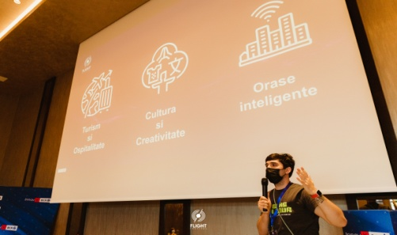
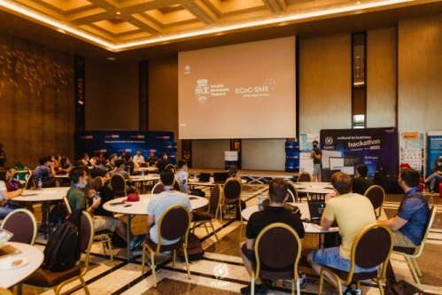
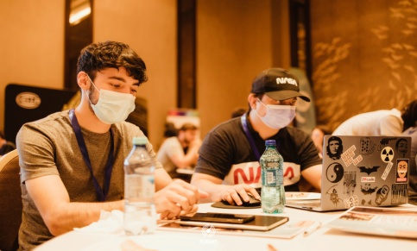
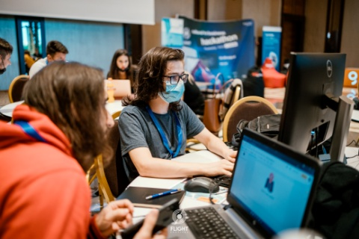
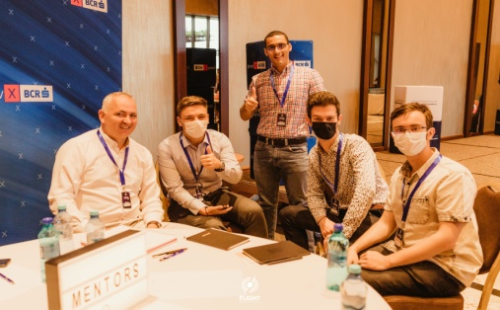
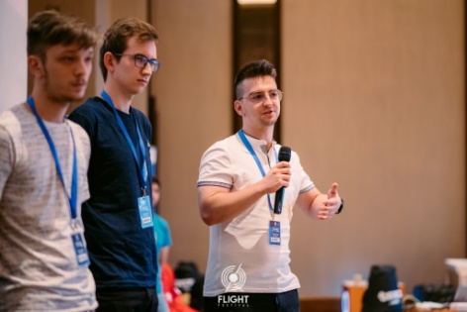
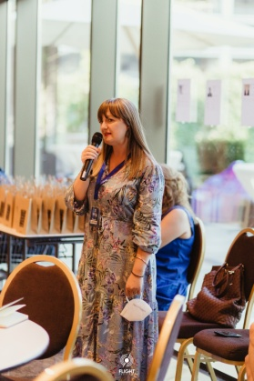
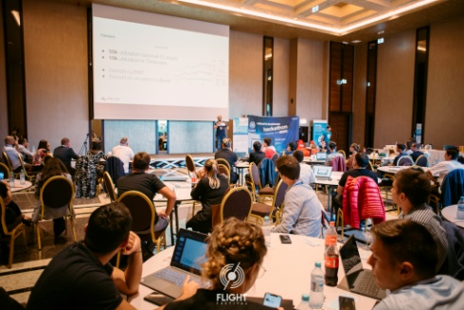
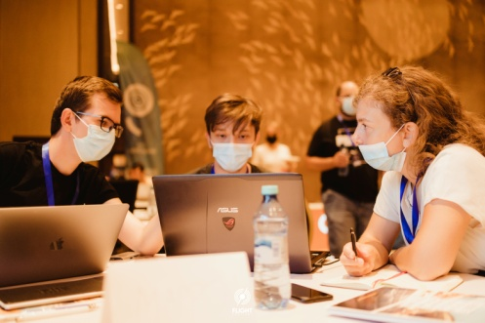
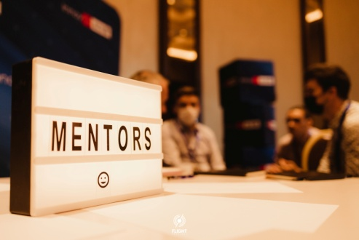
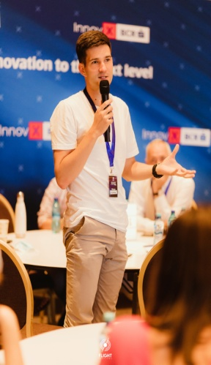
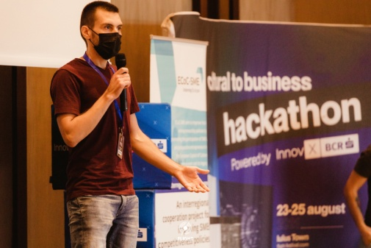
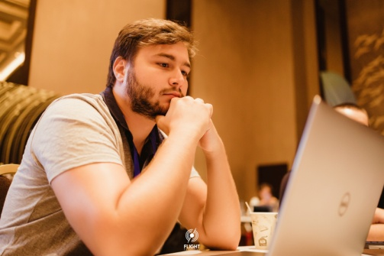
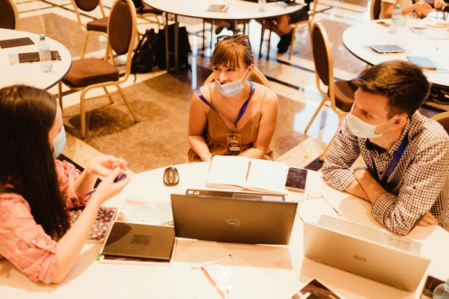
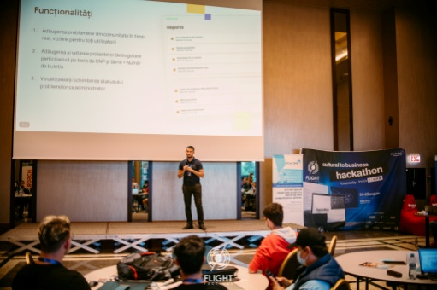
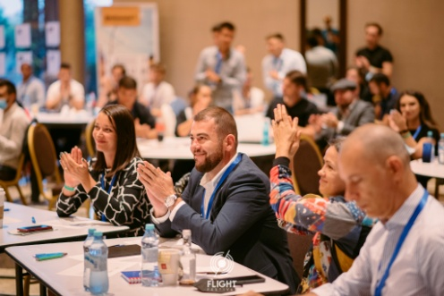
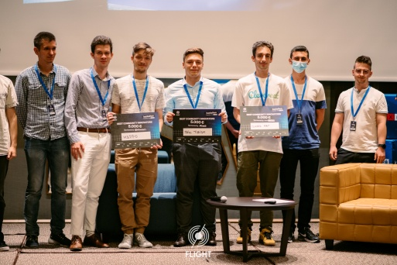

Slide 10
Thank you!
lavinia.simion@primariatm.ro

